Slide 1
Welcome
Sub:(DBMS)DATA BASE MANAGEMENT SYSTEM

Slide 2
UNIT I: DBMS Concepts
1.1 What is Data?
Data is a collection of a distinct small unit of information. It can be used in a variety of forms like text, numbers, media, bytes, etc. it can be stored in pieces of paper or electronic memory, etc.
In simple words, data can be facts related to any object in consideration.
For example, your name, age, height, weight, etc. are some data related to you. A picture, image, file, pdf, etc. can also be considered data.

Slide 3
What is Database?
.A database is an organized collection of data, so that it can be easily accessed and managed.
You can organize data into tables, rows, columns, and index it to make it easier to find relevant information.
Database handlers create a database in such a way that only one set of software program provides access of data to all the users. The main purpose of the database is to operate a large amount of information by storing, retrieving, and managing data.
There are many databases available like MySQL, Sybase, Oracle, MongoDB, Informix, PostgreSQL, SQL Server, etc.
Modern databases are managed by the database management system (DBMS).
SQL or Structured Query Language is used to operate on the data stored in a database.

Slide 4
DBMS (Data Base Management System)
Database management System is software which is used to store and retrieve the database. For example, Oracle, MySQL, etc.; these are some popular DBMS tools.
Database Management Systems (DBMS) are software systems used to store, retrieve, and run queries on data. A DBMS serves as an interface between an end-user and a database, allowing users to create, read, update, and delete data in the database.
DBMS provides the interface to perform the various operations like creation, deletion, modification, etc.
DBMS allows the user to create their databases as per their requirement.
DBMS accepts the request from the application and provides specific data through the operating system.
DBMS contains the group of programs which acts according to the user instruction.
It provides security to the database.

Slide 5
Architecture of DBMS – Three level
The DBMS design depends upon its architecture. The basic client/server architecture is used to deal with a large number of PCs, web servers, database servers and other components that are connected with networks.
The client/server architecture consists of many PCs and a workstation which are connected via the network.
DBMS architecture depends upon how users are connected to the database to get their request done.

Slide 6
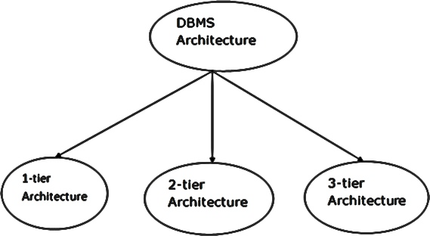
Three level-

Slide 7
1-Tier Architecture
In this architecture, the database is directly available to the user. It means the user can directly sit on the DBMS and uses it.
Any changes done here will directly be done on the database itself. It doesn't provide a handy tool for end users.
The 1-Tier architecture is used for development of the local application, where programmers can directly communicate with the database for the quick response.

Slide 8
2- Tier Architecture
The 2-Tier architecture is same as basic client-server. In the two-tier architecture, applications on the client end can directly communicate with the database at the server side. For this interaction, API's like: ODBC, JDBC are used.
The user interfaces and application programs are run on the client-side.
The server side is responsible to provide the functionalities like: query processing and transaction management.
To communicate with the DBMS, client-side application establishes a connection with the server side.

Slide 9
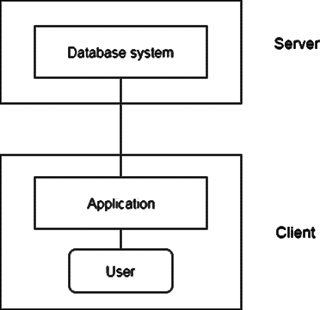
Fig: 2-tier Architecture

Slide 10
3-Tier Architecture
The 3-Tier architecture contains another layer between the client and server. In this architecture, client can't directly communicate with the server.
The application on the client-end interacts with an application server which further communicates with the database system.
End user has no idea about the existence of the database beyond the application server. The database also has no idea about any other user beyond the application.
The 3-Tier architecture is used in case of large web application.

Slide 11
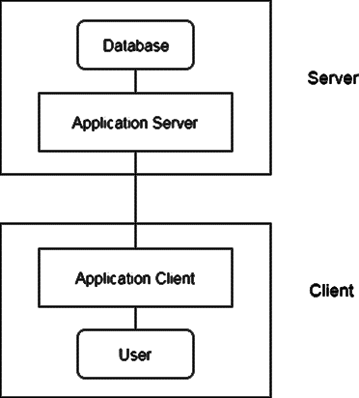
Fig: 3-tier Architecture

Slide 12
Structure of DBMS:
Structure of DBMS is software that allows access to data stored in a database
and provides an easy and effective method of –
Defining the information.
Storing the information.
Manipulating the information.
Protecting the information from system crashes or data theft.
Differentiating access permissions for different users.

Slide 13
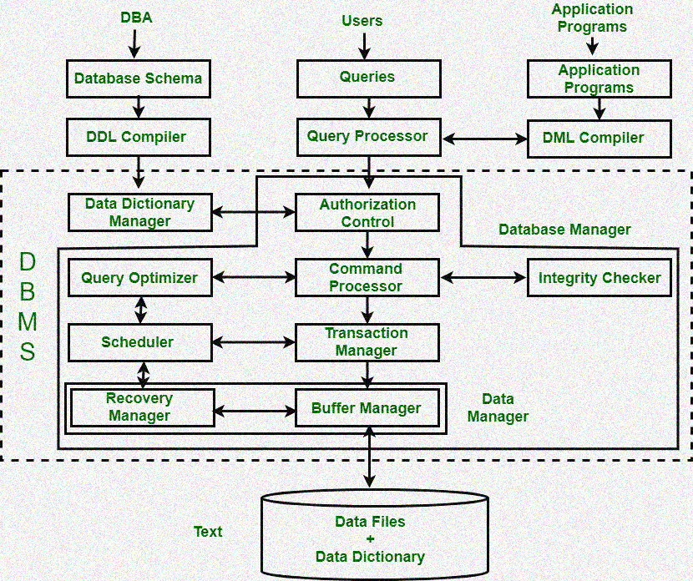

Slide 14
1. Query Processor:
1. Query Processor: It interprets the requests (queries) received from end user via an application program into instructions. It also executes the user request which is received from the DML compiler. Query Processor contains the following components –
DML Compiler: It processes the DML statements into low level instruction (machine language), so that they can be executed.
DDL Interpreter: It processes the DDL statements into a set of table containing meta data (data about data).
Embedded DML Pre-compiler: It processes DML statements embedded in an application program into procedural calls.
Query Optimizer: It executes the instruction generated by DML Compiler.

Slide 15
2.Storage Manager
It contains the following components –
Authorization Manager: It ensures role-based access control, i.e. checks whether the particular person is privileged to perform the requested operation or not.
Integrity Manager: It checks the integrity constraints when the database is modified.
Transaction Manager: It controls concurrent access by performing the operations in a scheduled way that it receives the transaction. Thus, it ensures that the database remains in the consistent state before and after the execution of a transaction.
File Manager: It manages the file space and the data structure used to represent information in the database.
Buffer Manager: It is responsible for cache memory and the transfer of data between the secondary storage and main memory.

Slide 16
3. Disk Storage
3. Disk Storage: It contains the following components –
Data Files: It stores the data.
Data Dictionary: It contains the information about the structure of any database object. It is the repository of information that governs the metadata.
Indices: It provides faster retrieval of data item.

Slide 17
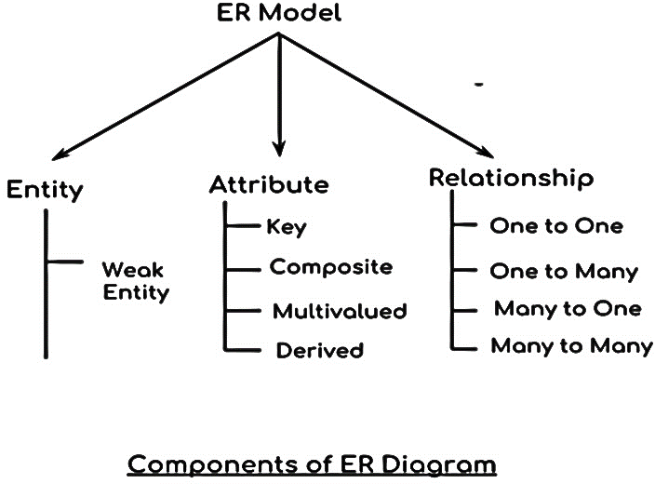
Entity, Attributes, type of relationships:

Slide 18
Entity: An entity is a “thing” or “object” in the real world.
An entity contains attributes, which describe that entity.
So anything about which we store information is called an entity.
Entities are recorded in the database and must be distinguishable,
i.e., easily recognized from the group.
For example: A student, an employee, or bank a/c, etc. all are entities.

Slide 19
Attributes: In DBMS, we have entities, and each entity contains some property about their behavior which is also called the attribute.
For example, in a student database, the attributes might be name, address, and phone number
Key attribute
Composite attribute
Multivalued attribute
Derived attribute

Slide 20
Type of relationships:

Slide 21
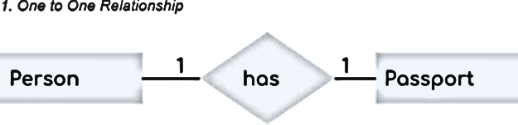
When a single instance of an entity is associated with a single instance of another entity then it is called one to one relationship.

Slide 22
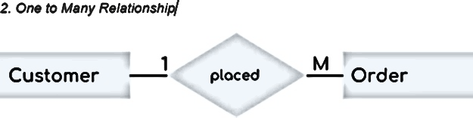
.When a single instance of an entity is associated with more than one instances of another entity then it is called one to many relationship.

Slide 23
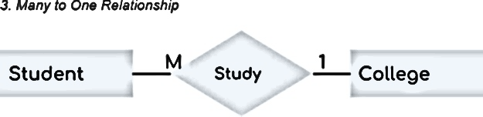
. When more than one instances of an entity is associated with a single instance of another entity then it is called many to one relationship

Slide 24
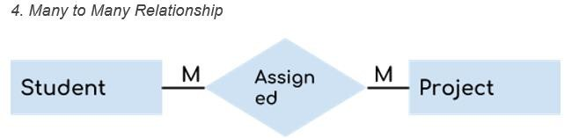
.When more than one instances of an entity is associated with more than one instances of another entity then it is called many to many relationship.

Slide 25
DBMS users:
1.Database Administrator (DBA):
Database Administrator (DBA) is a person/team who defines the schema and also controls the 3 levels of database.
The DBA will then create a new account id and password for the user if he/she need to access the data base.
DBA is also responsible for providing security to the data base and he allows only the authorized users to access/modify the data base.
DBA also monitors the recovery and back up and provide technical support.
.The DBA has a DBA account in the DBMS which called a system or super user account.
.DBA repairs damage caused due to hardware and/or software failures.

Slide 26
2.Naive / Parametric End Users:
Parametric End Users are the unsophisticated who don’t have any DBMS
knowledge but they frequently use the data base applications in their daily life to get the desired results.
For examples, Railway’s ticket booking users are naive users. Clerks in any bank is a naive user because they don’t have any DBMS knowledge but they still use the database and perform their given task.

Slide 27
3.System Analyst:
System Analyst is a user who analyzes the requirements of parametric end users.
They check whether all the requirements of end users are satisfied.

Slide 28
4.Sophisticated Users:
Sophisticated users can be engineers, scientists, business analyst, who are familiar with the database. They can develop their own data base
applications according to their requirement. They don’t write the program code but they interact the data base by writing SQL queries directly through the query processor.

Slide 29
5.Data Base Designers:
Data Base Designers are the users who design the structure of data base which includes tables, indexes, views, constraints, triggers, stored procedures.
He/she controls what data must be stored and how the data items to be related.

Slide 30
6.Application Program:
Application Program are the back end programmers who writes the code for the application programs. They are the computer professionals. These programs could be written in Programming languages such as Visual Basic, Developer, C, FORTRAN, COBOL etc.
Database users are categorized based up on their interaction with the data base. These are seven types of data base users in DBMS.

Slide 31
DBMS Facilities:
It provides facilities for defining the structure in which data is to be store on physical devices.
Which consist on those command that create the objects like table, index, view etc. in the data base Create, Drop and Alter are few commands of Data Definition
It provides facilities for entering changing and extracting data fro the data base. Data Manipulation Operation is also called Query and DML is also called a Query Language.
Select, Delete, Insert, Update are few commands of Data Manipulation Language. DCL is another facilities of DBMS that provides security

Slide 32
Advantages of DBMS:
Controls database redundancy
Data sharing
Easy Maintenance
Reduce time
Backup
Multiple user interfaces

Slide 33
Disadvantages of DBMS:
Cost of software and hardware
Size
Complexity
Higher impact of failure

Slide 34
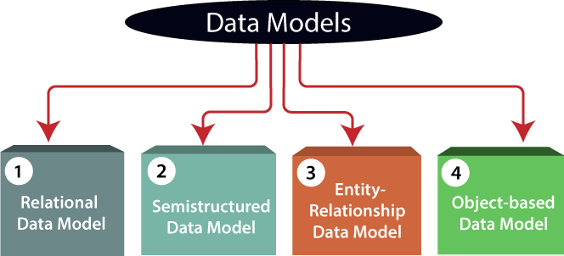
Data Models:

Slide 35
1.Relational Data Model:
Thus, a relational model uses tables for representing data and in-between relationships. Tables are also called relations.
The relational data model is the widely used model which is primarily used by commercial data processing applications.
Relational Model is the most widely used model. In this model, the data is maintained in the form of a two-dimensional table

Slide 36
2. Semi structured Data Model:
This type of data model is different from the other three data models.
The semi structured data model allows the data specifications at places where the individual data items of the same type may have different attributes sets.
The Extensible Markup Language, also known as XML, is widely used for representing the semi structured data.
In this model some entities may have missing attributes while others may have an extra attribute.

Slide 37
3.Entity-Relationship Data Model:
An ER model is the logical representation of data as objects and relationships among them.
These objects are known as entities, and relationship is an association among these entities.
This model was designed by Peter Chen and published in 1976 papers.
It was widely used in database designing. A set of attributes describe the entities.

Slide 38
4.Object-based Data Model:
An extension of the ER model with notions of functions, encapsulation, and object identity, as well.
This model supports a rich type system that includes structured and collection types.
Thus, in 1980s, various database systems following the object-oriented approach were developed.
Here, the objects are nothing but the data carrying its properties

Slide 39
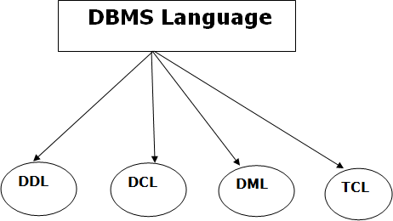
Database Language
Database Language

Slide 40
1.Data Definition Language
DDL stands for Data Definition Language. It is used to define database structure or pattern.
It is used to create schema, tables, indexes, constraints, etc. in the database
Here are some tasks that come under DDL:
Create: It is used to create objects in the database.
Alter: It is used to alter the structure of the database.
Drop: It is used to delete objects from the database.
Truncate: It is used to remove all records from a table.
Rename: It is used to rename an object.

Slide 41
2.Data Control Language
DCL stands for Data Control Language. It is used to retrieve the stored or saved data.
The DCL execution is transactional. It also has rollback parameters.
Grant: It is used to give user access privileges to a database.
Revoke: It is used to take back permissions from the user.

Slide 42
3.Data Manipulation Language
DML stands for Data Manipulation Language. It is used for accessing and manipulating data in a database. It handles user requests.
Here are some tasks that come under DML:
Select: It is used to retrieve data from a database.
Insert: It is used to insert data into a table.
Update: It is used to update existing data within a table.
Delete: It is used to delete all records from a table.

Slide 43
4.Transaction Control Language
TCL is used to run the changes made by the DML statement. TCL can be grouped into a logical transaction.
Here are some tasks that come under TCL:
Commit: It is used to save the transaction on the database.
Rollback: It is used to restore the database to original since the last Commit.

Slide 44
Thank you!

